Slide 1


Intro to P5.js and Snake
By Nicole McCabe
Week 3

Slide 2
What is P5.js?
P5.js is a JavaScript library based on Processing for artists, designers, and educators, with a specific focus on the visual arts.
It's an extremely easy way for you to create interactive pieces of art, animations and prototypes in the browser - you can think of your whole browser page as your sketch!
Very similar syntax to Processing.
Free and Open Source.
Game will run inside your browser!
How P5.js and Processing differ: https://github.com/processing/p5.js/wiki#how-is-this-different-than-processingjs

Slide 3
How to setup P5.js
Online Editor (no setup): https://editor.p5js.org/
Library download: https://p5js.org/download/
Reference Page: https://p5js.org/reference/
Tutorials: https://p5js.org/learn/
Examples: https://p5js.org/examples/

Slide 4
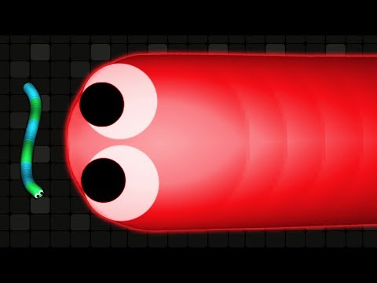
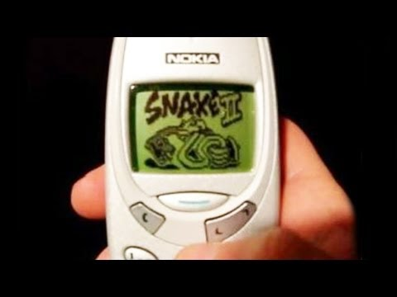
What is Snake? 🐍
Wikipedia: https://en.wikipedia.org/wiki/Snake_(video_game_genre)

Slide 5
Now let’s code Snake! 💻 🎉

